Slide 1
Beginners Coding Introduction Session
Vodafone Coding Club

Slide 2
Course Structure
Introduction
Learning how to use Katacoda
Session 1
Variables, inputs and comparisons
Session 2
Conditional statements and lists
Session 3
Loops and functions
Session 4
Working with spreadsheet data in python
Session 5
Classes

Slide 3
https://forms.office.com/Pages/ResponsePage.aspx?id=Oz8oaIeEhkyts6Uijxi4k9nG3Ek8_ZtJmQ0ugCHyjUZUMUNRSjkxU1RWUDlZQTJNSENNTkk5WFY2NSQlQCN0PWcu
Your Knowledge So Far:

Slide 4
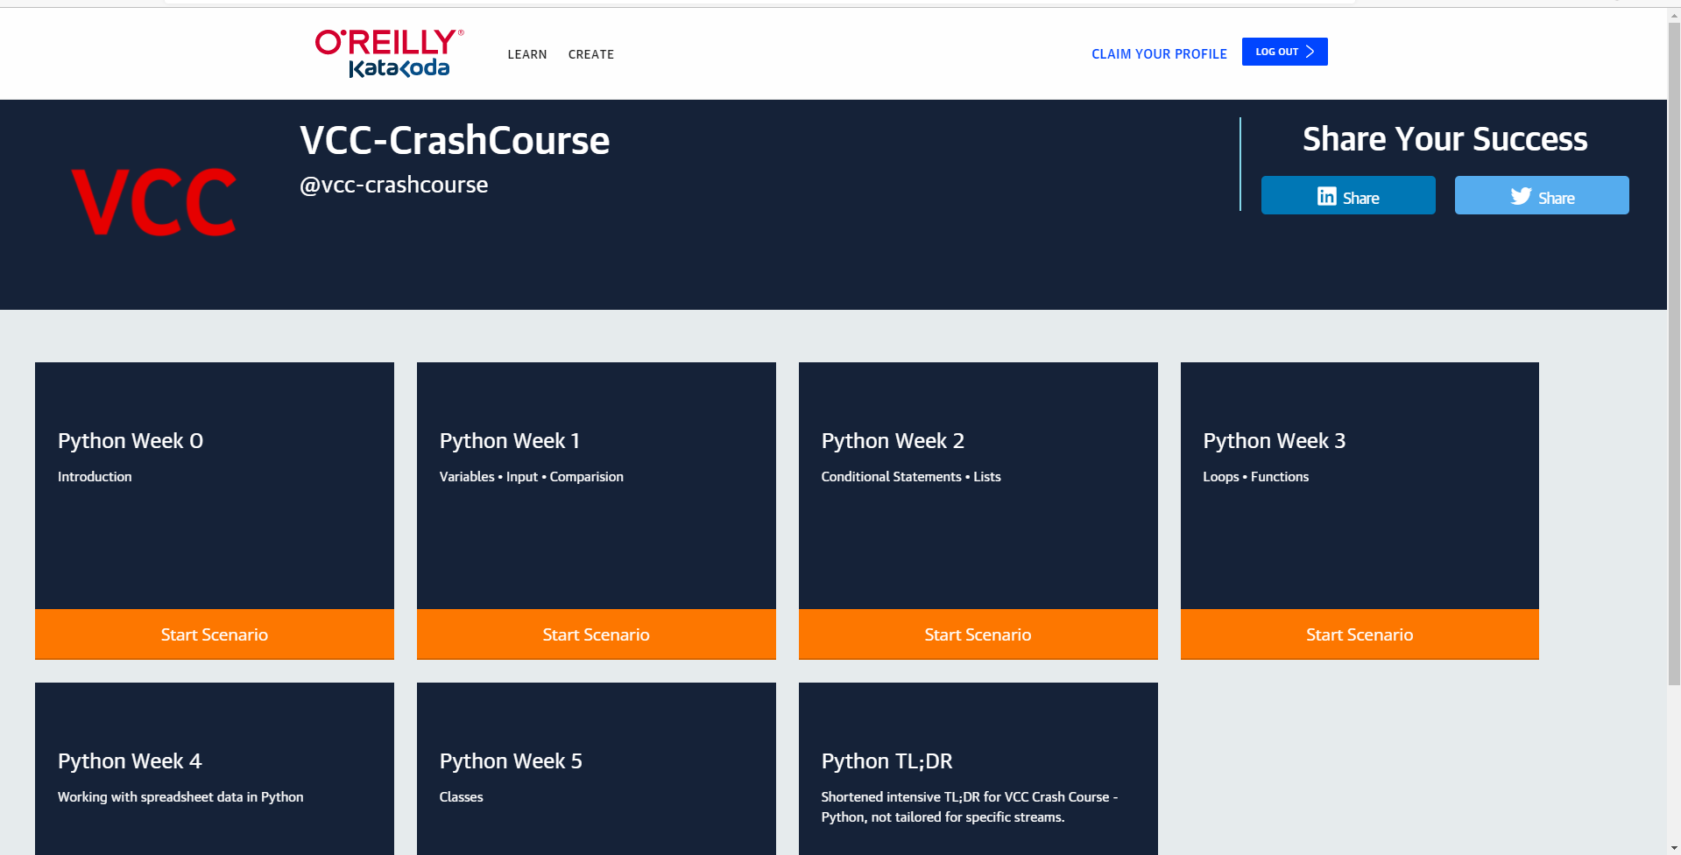
Create a Katacoda Account
Courses and scenarios authored by VCC-CrashCourse | Katacoda
Once Logged
in Select the
first scenario

Slide 5
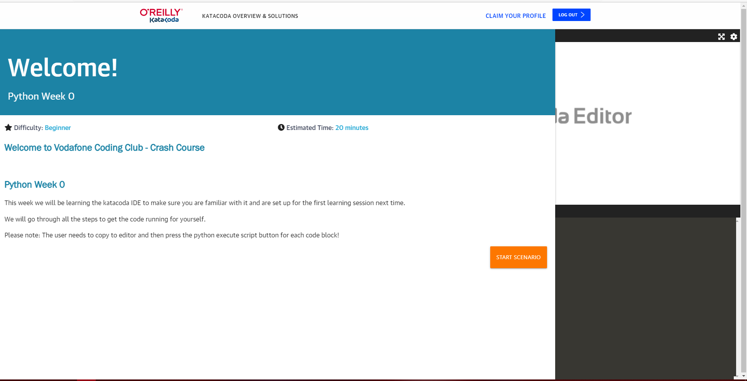
Loading the Scenario
You can read to get a
briefing before starting
the session

Slide 6
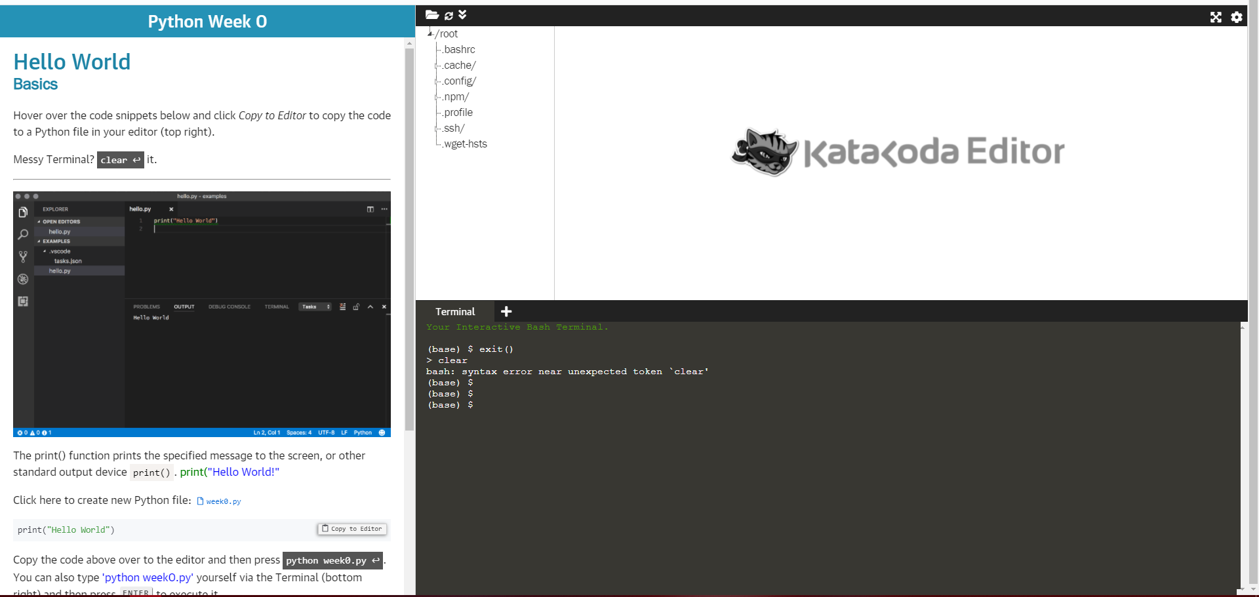
Using the katacoda editor
3.) The file will show here
with the code copied over.
4.) You can press this
To clear all the text
in the terminal in the
bottom right if its
getting messy.
2.) Click this text to
load up the file
that will be used to
code in.
1.) This is your terminal,
where you can run the code
and see the output.

Slide 7
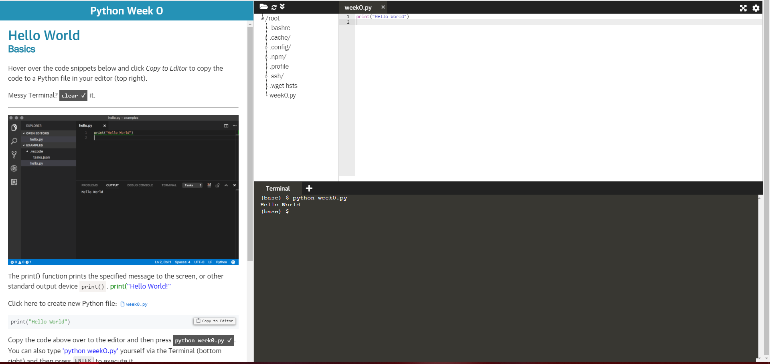
Running the code
By coping over the text
you can see the code copied
into the newly created file.
When you press the button on the left, the code
written in the file will run and here you can
see in the output it prints ‘Hello World’

Slide 8
Any questions please let one of us know before the first official session!

